Slide 1

Chapter 15::
Run-time Program Management
Programming Language Pragmatics
Michael L. Scott
Copyright © 2009 Elsevier

Slide 2
Introduction
Run-time system:
Refers to the set of libraries on which the language implementation depends for correct operation
  Some parts of the run-time, obtain all the information they need from subroutine arguments
  Others require more extensive knowledge of the compiler or the generated program.
Copyright © 2009 Elsevier

Slide 3
Introduction
Run-time system
Simple cases
This knowledge is a set of conventions that the compiler and runtime both respect.
More complex cases
        The compiler generates program-speciﬁc metadata that the runtime must inspect to do its job.
Copyright © 2009 Elsevier

Slide 4
Introduction
Many examples of compiler/runtime integration have been discussed:
  Garbage Collection (Section 7.7.3)
  Variable Numbers of Arguments (Section 8.3.3)
  Exception Handling (Section 8.5)
  Event Handling (Section 8.7)
  Coroutine & Thread Implementation (8.6 & 12.2.4)
  Remote Procedure Call (Section 12.5.4)
  Transactional Memory (Section 12.4.4)
  Dynamic Linking (Section 14.7)
Copyright © 2009 Elsevier

Slide 5
Introduction
The length and complexity of the list above generally means that the compiler and the run-time system must be developed together.
  Some languages have very small run-time systems: most user level code required to execute a given source program is either generated directly by the compiler or contained in language-independent libraries.
  Other languages have extensive run-time systems. e.g. C# is heavily dependent on a run-time system deﬁned by the Common Language Infrastructure standard which depends on data generated by the compiler
Copyright © 2009 Elsevier

Slide 6
Virtual Machines
A virtual machine (VM) provides a complete programming environment
  Its application programming interface (API) provides all requirements for execution of programs that run above it
  Is term used for environments whose level of abstraction is comparable to that of a computer implemented in hardware
Copyright © 2009 Elsevier

Slide 7
Virtual Machines
Virtual machines tend to be characterized as either:
  System VM
    Faithfully emulates all the hardware facilities needed to run a standard OS, including both privileged and unprivileged instructions, memory-mapped I/O, virtual memory, and interrupt facilities. (sometimes referred to as virtual machine monitors (VMMs))
  Process VM
    Provides the environment needed by a single user-level process: the unprivileged subset of the instruction set and a library-level interface to I/O and other services.
Copyright © 2009 Elsevier

Slide 8
Virtual Machines
The Java Virtual Machine (JVM)
  Started as a development of the language Java in 1990–91 at Sun Microsystems 1st public release of Java occurred in 1995
  Code in the JVM was entirely interpreted
  JIT compiler added in 1998, with release of Java 2
Copyright © 2009 Elsevier

Slide 9
Virtual Machines
JVM Architecture Summary
  Interface provided by JVM designed as target for a Java compiler
  Provides direct support for all the built-in and reference types deﬁned by the Java language
  Enforces both deﬁnite assignment (Section 6.1.3) & type safety.
  Includes built-in support for many of Java’s language features & standard library packages, including exceptions, threads, garbage collection, reﬂection, dynamic loading, & security
  Usually Java byte code (JBC) is produced from Java source- however, compilers targeting the JVM exist for many languages, including Ruby, JavaScript, Python, Scheme, C, Ada, Cobol, & others
Copyright © 2009 Elsevier

Slide 10
Virtual Machines
JVM Storage Management Storage allocation mechanisms in the JVM mirror those of the Java language:
  Global constant pool
  Set of registers
  Stack for each thread
  Method area to hold executable byte code
  Heap for dynamically allocated objects
Copyright © 2009 Elsevier

Slide 11
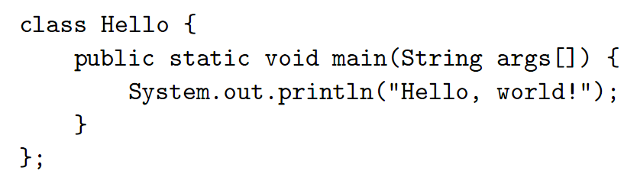
Virtual Machines
A trivial “Hello, world” program (Example 15.2):
Copyright © 2009 Elsevier

Slide 12
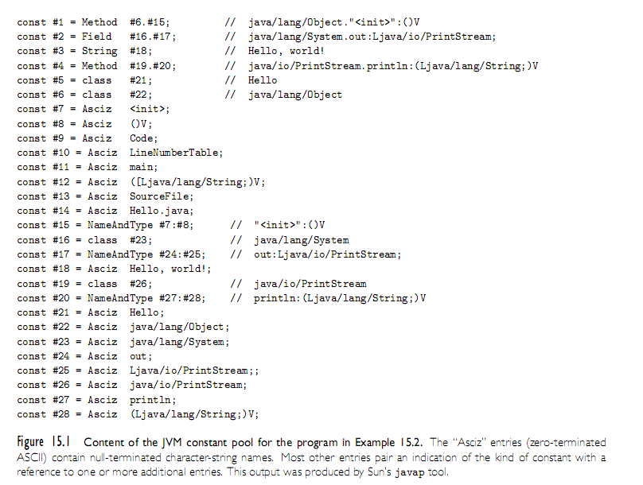
Virtual Machines
Copyright © 2009 Elsevier

Slide 13
Virtual Machines
JVM Class Files
      Class ﬁle is stored as a stream of bytes
        Typically, real file provided by the operating system, could just as easily be a record in a database
      Multiple class ﬁles may be combined into a Java archive (.jar ) ﬁle
Copyright © 2009 Elsevier

Slide 14
Virtual Machines
JVM Byte Code (JBC)
Stack oriented, operands and results of arithmetic
and logic instructions are kept in the operand stack
of the current method frame, rather than in registers
Instruction set, version 2 categories:
      - load/store
      - arithmetic
      - type conversion
      - object management
      - operand stack management
      - control transfer
      - method calls
      - exceptions & monitors
Copyright © 2009 Elsevier

Slide 15
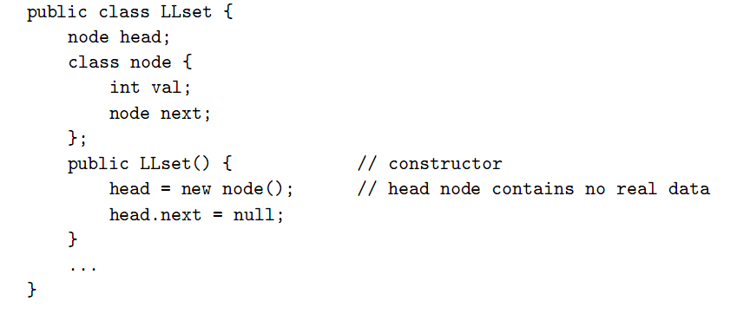
Virtual Machines
JVM byte code for a list insert (Example 15.3):
Copyright © 2009 Elsevier

Slide 16
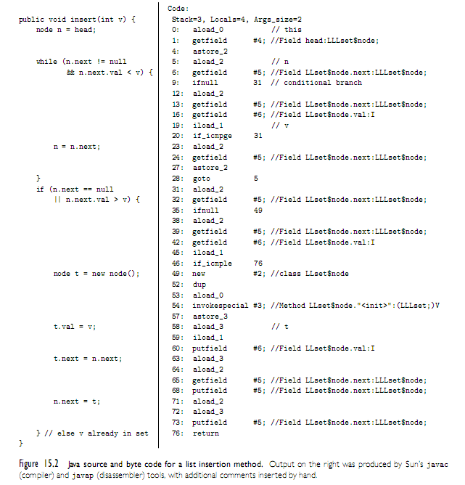
Virtual Machines
Figure 15.2 Java source and byte code for a list insertion method (Example 15.3):
Copyright © 2009 Elsevier

Slide 17
Virtual Machines
Common Language Infrastructure (CLI)
      Began at Microsoft Corporation in the late 1990s
      Need for interoperability among programming languages running on Windows platforms
      • For .NET, a speciﬁcation for CLI virtual machine was
      standardized by ECMA in 2001
Copyright © 2009 Elsevier

Slide 18
Virtual Machines
Architecture and Comparison to the JVM
Similarities between CLI and JVM:
  Both systems deﬁne a multithreaded, stack-based virtual machine, with built-in support for garbage collection, exceptions, virtual method dispatch, and mix-in inheritance.
  Both represent programs using a platform-independent, self-descriptive, byte code notation.
  - For languages like C#, the CLI provides all the safety of the JVM, including deﬁnite assignment, strong typing, and protection against overﬂow or underﬂow of the operand stack.
Copyright © 2009 Elsevier

Slide 19
Virtual Machines
Architecture and Comparison to the JVM
Contrasts between CLI and JVM:
  Richer type system for CLI
  Richer calling mechanisms in CLI
  Unsafe code made explicit in CLI
  - Miscellaneous CLI support
Copyright © 2009 Elsevier

Slide 20
Virtual Machines
The Common Type System
Built-in Types
Integers
  in 8, 16, 32, and 64 bit lengths, both signed and unsigned
“Native” integers
  supported by hardware, again both signed and unsigned
- IEEE ﬂoating-point
  both single and double precision Object references and “managed” pointers
Copyright © 2009 Elsevier

Slide 21
Virtual Machines
The Common Type System
Constructed Types
Dynamically allocated instances of class, interface, array, and delegate types
Methods – function types
Properties – getters and setters for objects
Events – lists of delegates, associated with an object
Value types – records (structures), unions, & enumerations
Boxed value types – values embedded in dynamically allocated object
Function pointers – references to static functions
Typed references – pointers bundled, with type descriptor
Unmanaged pointers – as in C, can point to just about anything, & support pointer arithmetic
Copyright © 2009 Elsevier

Slide 22
Virtual Machines
The Common Language Speciﬁcation
Deﬁnes subset of CTS that most languages can accommodate
Omits several of the types provided by the CTS
Imposes restrictions on the use of other types; establishes naming conventions, limits the use of overloading, and deﬁnes the operators and conversions that programs can assume are supported on built-in types
None of these restrictions applies to program components that operate only within a given language
Copyright © 2009 Elsevier

Slide 23
Virtual Machines
Metadata and Assemblies
Portable Executable (PE) assemblies are the rough equivalent of Java .jar ﬁles
Contain the code for a collection of CLI classes based on the Common Object File Format (COFF), originally developed for AT&T’s System V Unix.
The Common Intermediate Language (CIL)
  Version 4 of ECMA standard deﬁnes approximately 250 instructions
  CIL bears a strong resemblance to JBC
  Any differences stem from the assumption that CIL will always be JIT-compiled
Copyright © 2009 Elsevier

Slide 24
Late Binding of Machine Code
Just-in-Time (JIT) and Dynamic Compilation
JIT system compiles programs immediately prior to execution, can add signiﬁcant delay to program start-up time
Cost of JIT compilation is typically lessened by the existence of an earlier source-to-byte-code compilere.g. Java byte code (JBC)
Copyright © 2009 Elsevier

Slide 25
Late Binding of Machine Code
Dynamic Compilation
In some cases JIT compilation must be delayed, either because:
  Source or byte code was not created or discovered until run time
  Perform optimizations that depend on information gathered during execution
Common Lisp, the language is typically compiled, but a program can extend itself at run time
Copyright © 2009 Elsevier

Slide 26
Late Binding of Machine Code
Binary Translation
Recompilation of object code
Allows already-compiled programs to be run on a machine with a different instruction set architecture
e.g. Apple’s Rosetta system, which allows programs compiled for older PowerPC-based Macintosh computers to run on newer x86-based Macs
Copyright © 2009 Elsevier

Slide 27
Late Binding of Machine Code
Binary Translation
Principal challenge is loss of information in the original source-to-object code translation
  Object code typically lacks both type information and clearly-delineated subroutines and control-ﬂow constructs of source code and byte code
  Yet most of this information appears in compiler’s symbol table
Copyright © 2009 Elsevier

Slide 28
Late Binding of Machine Code
Binary Translation
Typical binary translator reads an object ﬁle & reconstructs control ﬂow graph (cf. Section 14.1.1)
  Task complicated by lack of explicit information about basic blocks.
  While branches (the ends of basic blocks) are easy to identify, beginnings are more difﬁcult: since branch targets are sometimes computed at run time or looked up in dispatch tables or virtual function tables
Copyright © 2009 Elsevier

Slide 29
Late Binding of Machine Code
Binary Rewriting
Technique to modify existing executable code can be used for:
  Profiling (insert instrumentation of some kind)
  Simulate new architectures
  Evaluate the coverage of test suites- implement model checking for parallel programs, a process that exposes race conditions
  “Audit” the quality of a compiler’s optimizations- insert dynamic semantic checks into a program
  “Sandbox” untrusted code, permits an safe execution in same address space as application.
Copyright © 2009 Elsevier

Slide 30
Late Binding of Machine Code
Mobile Code and Sandboxing
  Portability is one of the principal motivations for late binding of machine code.
  Code compiled for one machine architecture or operating system cannot generally be run on another due to dependencies.
  For code to be mobile, it must be executed in some sort of sandbox.
  Sandbox mechanisms lie at the boundary between language implementation and operating systems.
Copyright © 2009 Elsevier

Slide 31
Inspection/Introspection
Reﬂection
  Load already-compiled program, to use reﬂection tools for querying symbol table information created by compiler
  E.g. reﬂection useful when printing diagnostics
Copyright © 2009 Elsevier

Slide 32
Inspection/Introspection
Reﬂection
  C#’s reﬂection API is similar to that of Java:
    System.Type is analogous to java.lang.Class
    System. Reflection is analogous to java.lang.reflect
  All of the major scripting languages (Perl, PHP, Tcl, Python, Ruby, JavaScript) provide extensive reﬂection mechanisms
  Principal difference between reﬂection in Java or C# and in scripting languages (Lisp) is the later is dynamically typed
Copyright © 2009 Elsevier

Slide 33
Inspection/Introspection
Symbolic Debugging
Built into most programming language interpreters, virtual machines, and integrated program development environments
Also available as stand-alone tools e.g. GNU's gdb
Adjective symbolic refers to a debugger’s understanding of high level language syntax
Copyright © 2009 Elsevier

Slide 34
Inspection/Introspection
Symbolic Debugging
Debugger allows the user to perform two main kinds of operations:
  Breakpoint: speciﬁes that execution should stop if it reaches a particular location in the source code.
  Watchpoint: speciﬁes that execution should stop if a particular variable is read or written.
Copyright © 2009 Elsevier

Slide 35
Inspection/Introspection
Symbolic Debugging
Both data and control operations also depend on the ability to manipulate a program from outside:
  To stop and start it, and to read and write its data.
Debugger control can be implemented:
  Interpreters
  Dynamic binary rewriting- support from operating system(compiled programs only)
Some processors provide hardware support
Copyright © 2009 Elsevier

